Slide 1


Data Scientist (KTP Associate)
Tan Jian Sean
23 Apr 2024
Notes:
Good afternoon, my name is Tan Jian Sean
Applying for the KTP Associate Data Scientist Position
Presenting the coding assessment for this application
Before starting, make sure everyone SEE MY SCREEN & HEAR ME CLEAR
Will try to keep it simple and short, while making sure there is enough context to be understandable
Please bear with me :D

Slide 2
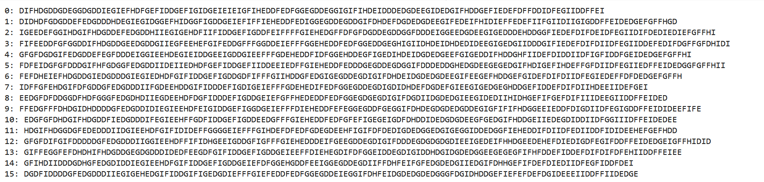
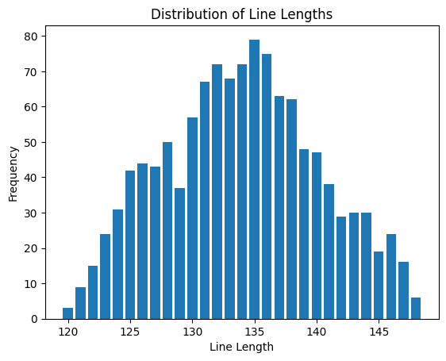
Data Exploratory Tasks Task 1: Clustering Solution Task 2: Generation Solution Technical Details
A series of 1200 sequences
6-character types: ‘D’, ‘E’, ‘F’, ‘G’, ‘H’, ‘I’
Sequence lengths ranging from 120~148
Notes:
Lets start with the data

Slide 3
Data Exploratory Tasks Task 1: Clustering Solution Task 2: Generation Solution Technical Details
Task 1: Clustering
cluster the sequences into an appropriate number of groups
identify the outliers
Task 2: Generation
generate a novel prototypical sequence for each cluster
Novel means the sequence is not from the original data

Slide 4
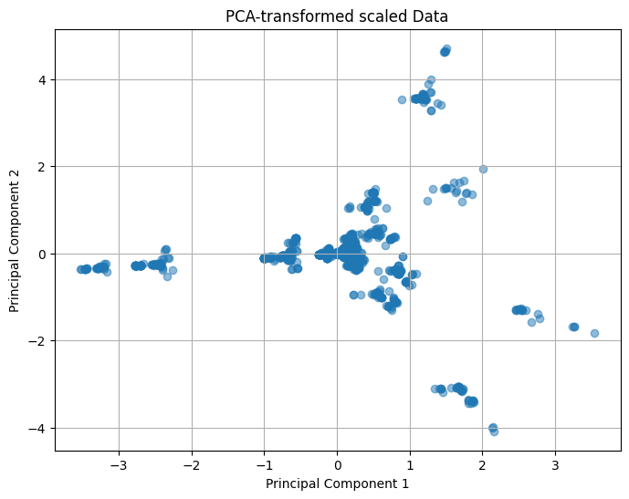
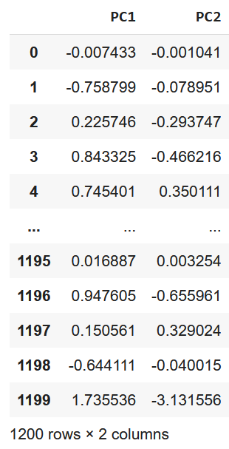
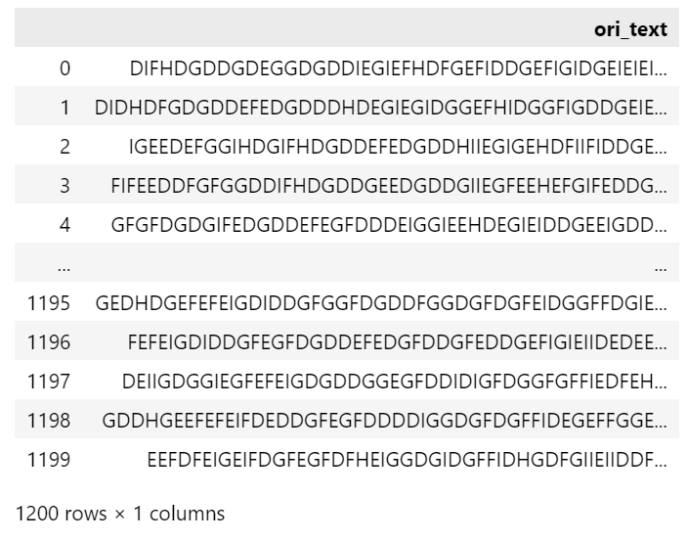
Data Exploratory Tasks Task 1: Clustering Solution Task 2: Generation Solution Technical Details
Data preprocessing:
Converting each sequences to a 6 dimensional vectors
counting the occurrence of the 6 unique characters
With some other processing technique like weighting & normalization*
Principle Component Analysis (PCA) – 2 dimensional vector
Reduce redundancy
2-dimensional data is easier to visualise
Vectorization, Normalization & PCA
Original Data
Preprocessed Data
*Will dive into later…
Notes:
Need to vectorize each sequence so that we can apply ML techniques
Will first turn into 6-dim vector
Then 2 dim vector
Feature selection reduce dimension, allows us to remove redundancy and work with data in an efficient manner
To show the visualization of the PCA-transformed data:
Looks like there are some distinct clusters!

Slide 5
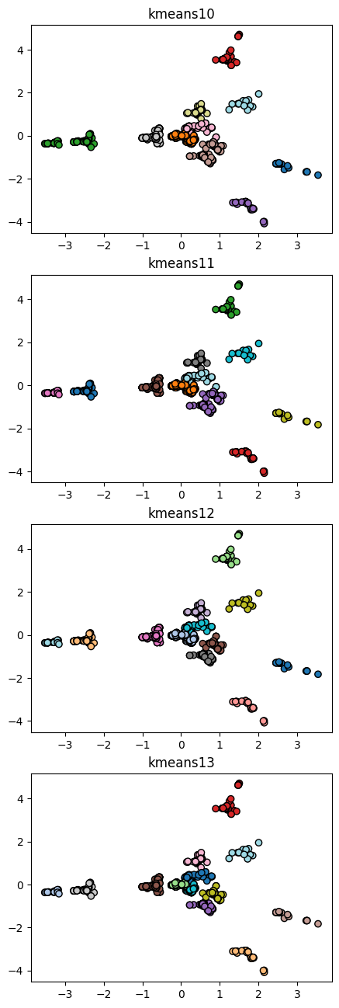
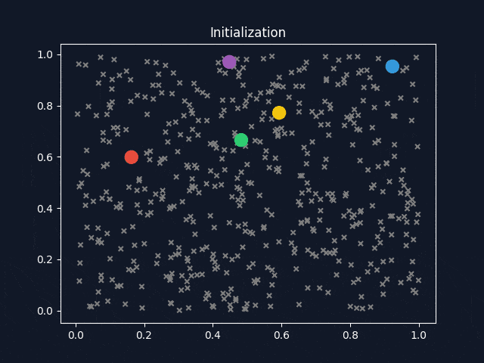
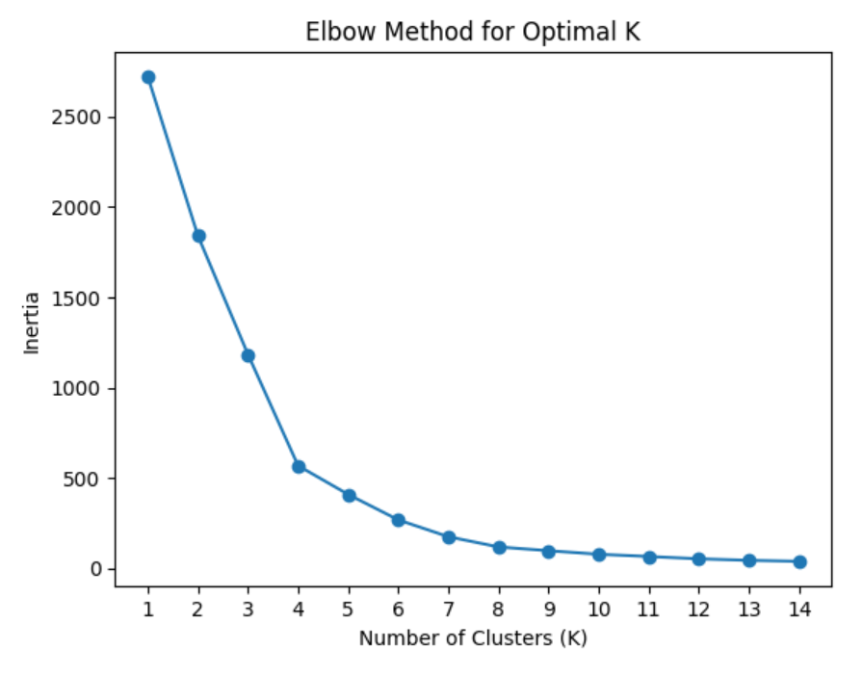
Data Exploratory Tasks Task 1: Clustering Solution Task 2: Generation Solution Technical Details
k-Means Clustering
An iterative process :
Starts with a set k-number of centroids
Each iteration will recompute the centroids of clusters
Until convergence
Metric: Inertia
Distance to respective centroid
Lower is better
Elbow method
Try to identify the k-number where the performance gain stagnated
Notes:
-show gif when talking about steps
- Inertia is the sum of square distances

Slide 6
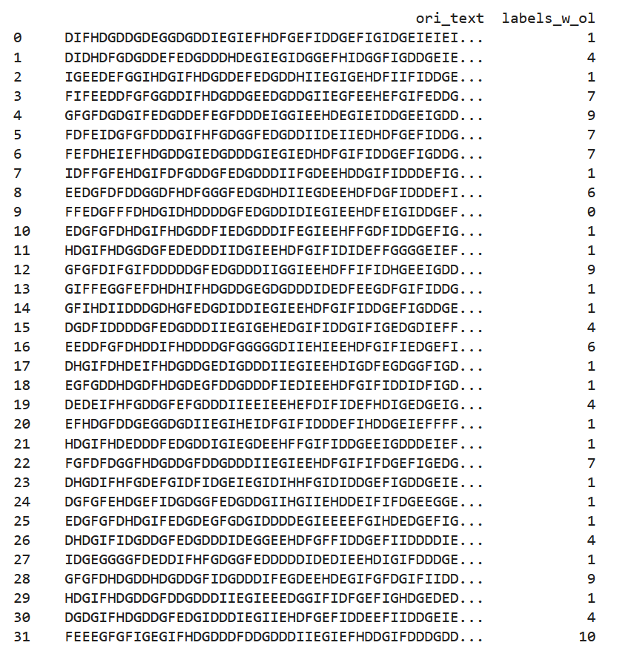
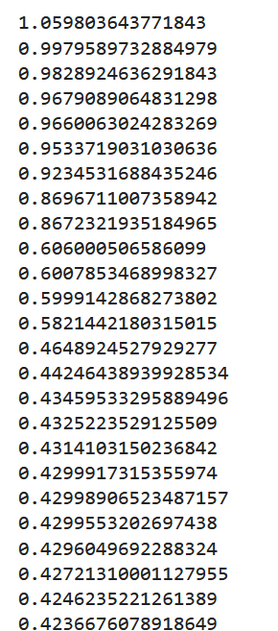
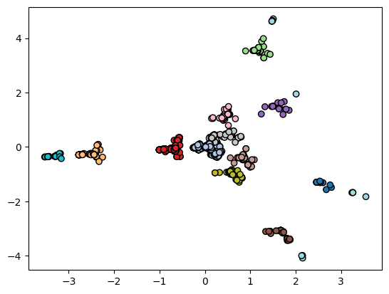
Data Exploratory Tasks Task 1: Clustering Solution Task 2: Generation Solution Technical Details
Outliers Detection
Sort the inertia of all data points
Take a cut-off at distance >= 0.6 for outliers
check with visualization
Conclusion: We have 12 clusters and 11 outliers (distance >= 0.6) !
Notes:
Use laser to circle out outliers in graph
Then present the snippet of clustering

Slide 7
Data Exploratory Tasks Task 1: Clustering Solution Task 2: Generation Solution Technical Details
Markov Chain
uses given data to record transition probability (one character to another)
Use the transition probability for generation
Key ingredients: transition matrix & initial state vector
Take one cluster for example. Transition matrix is attained by:
going through all the sequences in the cluster and
recording the transitions of character
then divide by the total number of transitions, to get the probability
E.g. if a simplified sequence is: DIFHDGDDGD:
Count of the transitions
Divide by total transitions to get probability
 | D | E | F | G | H | I
D | - | - | - | - | - | 1
E | - | - | - | - | - | -
F | - | - | - | - | - | -
G | - | - | - | - | - | -
H | - | - | - | - | - | -
I | - | - | - | - | - | -
 | D | E | F | G | H | I
D | - | - | - | - | - | 1
E | - | - | - | - | - | -
F | - | - | - | - | - | -
G | - | - | - | - | - | -
H | - | - | - | - | - | -
I | - | - | 1 | - | - | -
 | D | E | F | G | H | I
D | - | - | - | - | - | -
E | - | - | - | - | - | -
F | - | - | - | - | - | -
G | - | - | - | - | - | -
H | - | - | - | - | - | -
I | - | - | - | - | - | -
 | D | E | F | G | H | I
D | 1 | - | - | 2 | - | 1
E | - | - | - | - | - | -
F | - | - | - | - | 1 | -
G | 2 | - | - | - | - | -
H | 1 | - | - | - | - | -
I | - | - | 1 | - | - | -
 | D | E | F | G | H | I
D | - | - | - | - | - | 1
E | - | - | - | - | - | -
F | - | - | - | - | 1 | -
G | - | - | - | - | - | -
H | - | - | - | - | - | -
I | - | - | 1 | - | - | -
 | D | E | F | G | H | I
D | 1/9 | - | - | 2/9 | - | 1/9
E | - | - | - | - | - | -
F | - | - | - | - | 1/9 | -
G | 2/9 | - | - | - | - | -
H | 1/9 | - | - | - | - | -
I | - | - | 1/9 | - | - | -
transition matrix
Notes:
briefly mention that there is 10 char, so 9 transitions then click animation

Slide 8
Data Exploratory Tasks Task 1: Clustering Solution Task 2: Generation Solution Technical Details
initial state vector, or “seed”, is attained by:
similarly to the transition matrix but only for the start character
no transition involved
E.g. a sample cluster with 7 simplified series:
DIFHDGDDGD
DIDHDFGDGD
IGEEDEFGGI
FIFEEDDFGF
GFGFDGDGIF
FDFEIDGFGF
FEFDHEIEFH
The probability of the seed for this sample cluster can be obtained by:
Count of the start character
Divide by the total number of seeds to get prob.
D | E | F | G | H | I
2 | - | 3 | 1 | - | 1
D | E | F | G | H | I
2/7 | - | 3/7 | 1/7 | - | 1/7
initial state vector probability matrix

Slide 9
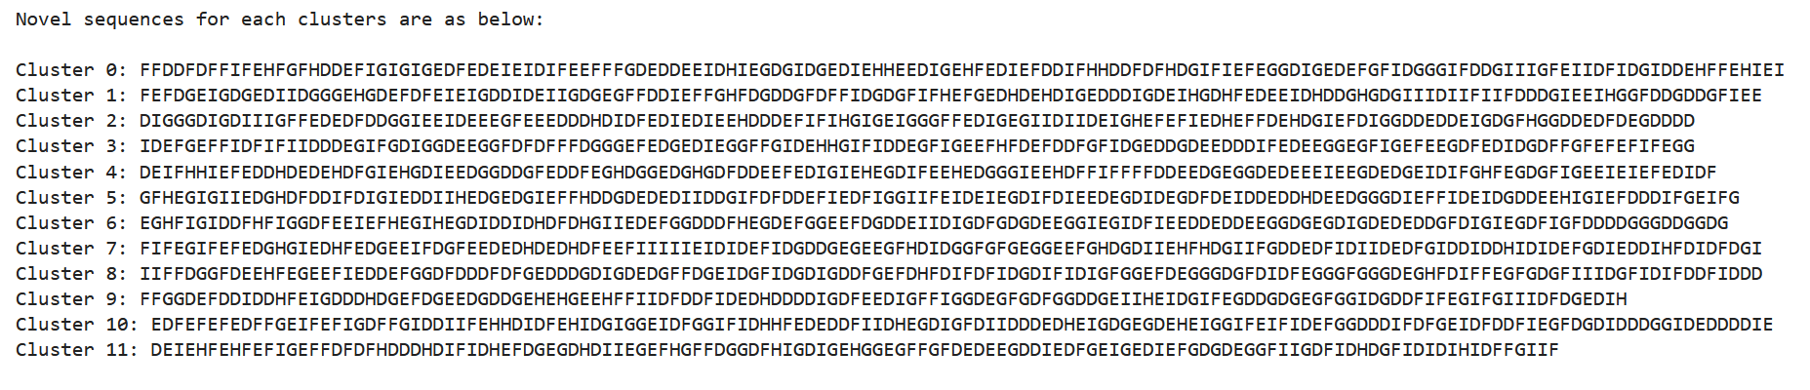
Data Exploratory Tasks Task 1: Clustering Solution Task 2: Generation Solution Technical Details
Generation is therefore achieved by:
starting with a seed
then keep on calling on random next character following the probability of transition matrix
Until the desired generation length is reached
D | E | F | G | H | I
2/7 | - | 3/7 | 1/7 | - | 1/7
F
 | D | E | F | G | H | I
D | 1/9 | - | - | 2/9 | - | 1/9
E | - | - | - | - | - | -
F | - | - | - | - | 1/9 | -
G | 2/9 | - | - | - | - | -
H | 1/9 | - | - | - | - | -
I | - | - | 1/9 | - | - | -
…
H
D
Notes:
Now we have the ingredients needed: transition matrix & initial state vector, we can perform the generation task
Using the sample matrices we used in previous slides, First we generate a seed
Then we generate the next character according to the probability
Then the next following char…
Again, just to show the actual novel sequences generated in my Python notebook…

Slide 10





Data Exploratory Tasks Task 1: Clustering Solution Task 2: Generation Solution Technical Details – Task 1
Tools used:
Jupyter Notebook
Libraries
Numpy
Pandas
Sklearn
Matplotlib
Data Structures
Lists – expandable, convert to DataFrames, use in loop
DataFrames – store & view multidimensional data with idx
Dictionaries – store features of 6 different characters: idx, count, weight
Notes:
List is used as expandable storage for items, can be converted to dataframes easily, also store things for looping
Dataframes is used to store the data where I want a better glance of data & idx, also can store different data types, can have label with data with weights…, easy slicing, good for visualisation
Dictionaries is used to store the records for different character per row, essentially
** also use array instead of list in some of the cases? If we really wanna squeeze efficiency, as the dimension is all known

Slide 11
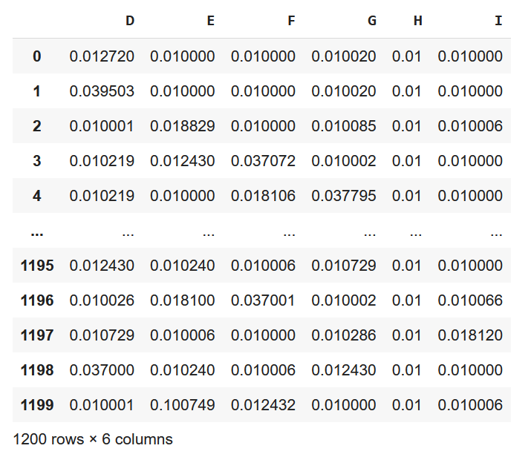
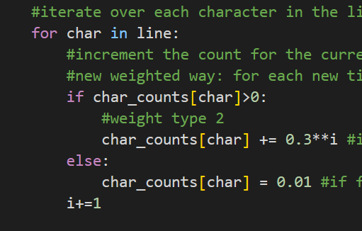
Data Exploratory Tasks Task 1: Clustering Solution Task 2: Generation Solution Technical Details – Task 1
Vectorization – 6 dim vector
counting the occurrence of each character type
To account for the order of character:
Assign front-heavy weights to the occurrences
indicates earlier characters are more important
Normalization
StandardScaler()
Character Weighting code snippet
6 dimensional vector
Notes:
Higher Weights for the earlier occurrences of characters
Scaling the mean and unit variance to 0, so the number will have range of negative to positive, standardization is sensitive to outliers
** enhancement: can get all the stuff needed for clustering & generation in one go, then do the tasks
** also can implement the weightage (front heavy) to generation as well, add in new element to transition matrix?

Slide 12
Data Exploratory Tasks Task 1: Clustering Solution Task 2: Generation Solution Technical Details – Task 2
Transition Matrix
Used when calling np.random.choice, with the p argument being:
a slice of the transition matrix (1D array with a size of 6)
Slice according to current character
E.g. current char is D:
Initial State Vector, or “seed”
Generated similarly as a transition matrix
But the probability is a 1D array with a size of 6
Hence there is no need to slice for argument p
Both the matrices above cannot have null values, there will be an error when input to np.random.choice. In the unlikely case, replace with 0 instead.
 | D | E | F | G | H | I
D | 1/9 | - | - | 2/9 | - | 1/9
E | - | - | - | - | - | -
F | - | - | - | - | 1/9 | -
G | 2/9 | - | - | - | - | -
H | 1/9 | - | - | - | - | -
I | - | - | 1/9 | - | - | -
D | E | F | G | H | I
2/7 | - | 3/7 | 1/7 | - | 1/7
Notes:
Shows matrix after talking about tm
Shows matrix after talking about seed
**probabilities does not have to add up to 1, it represents the relative likelihood (not super legit source…)
There are issues found online where ppl use np.random.multinomial or normalize the p again by dividing to the sum…

Slide 13
Data Exploratory Tasks Task 1: Clustering Solution Task 2: Generation Solution Technical Details – Task 2
Generation
To guarantee a novel sequence we implement a while loop:
set the first sequence of the dataframe (cluster) as new_string
while new_string is in the dataframe, the loop will go on, then upon generation assign new_string to the novel sequence
Evaluation of generation quality is done by implementing k-means of the same k(=12) to the original data combined with novel sequences and comparing the inertia.
If the inertia decreases or has minimal increase, the generation is of good quality
Generation length is randomly decided given the maximum and minimum sequence length in the cluster (using np.random.randint)
Notes:
np.random.randint takes in two values that determine the range

Slide 14
THE END

Slide 15
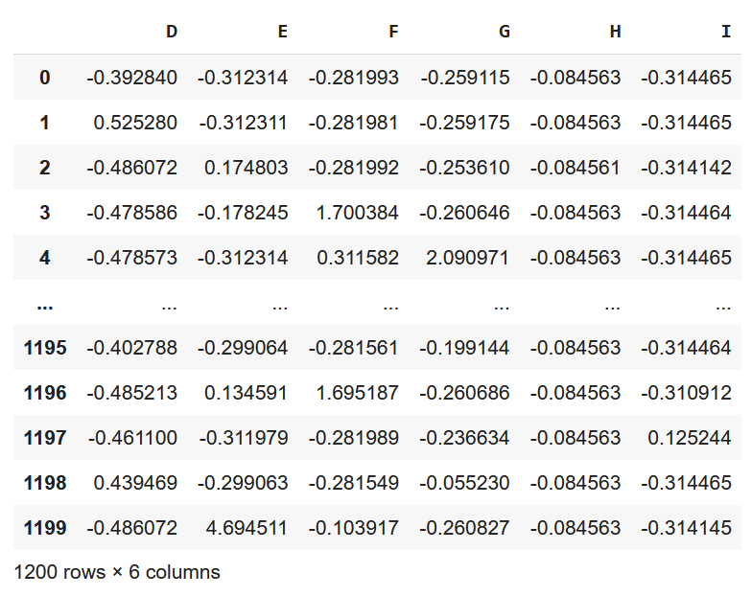
Data Exploratory Tasks Task 1: Clustering Solution Task 2: Generation Solution Technical Details
Data preprocessing:
Vectorization – 6 dimensional vector
counting the occurrence of each character type
Assigning front-heavy weights to the occurrences
accounts for the order of character where earlier characters are more important
Normalisation – 6 dimensional vector
StandardScaler()
Principle Component Analysis (PCA) – 2 dimensional vector
A form of feature selection
2-dimensional data is easier to visualise
Vectorization
Normalization
PCA
Notes:
Higher Weights for the earlier occurrences of characters
Scaling the mean and unit variance to 0, so the number will have range of negative to positive, standardization is sensitive to outliers
Feature selection reduce dimension, allows us to remove redundancy and work with data in an efficient manner
To show the visualization of the PCA-transformed data:
Looks like there are some distinct clusters!

Slide 16
Data Exploratory Tasks Task 1: Clustering Solution Task 2: Generation Solution Technical Details
Markov Chain
deals with sequential data: uses past empirical data to record transition probability
The transition probability for future prediction
Key ingredients: transition matrix & initial state vector
Take one cluster for example. Transition matrix is attained by:
going through all the sequences in the cluster and recording the transitions of character
then divide by the total number of transitions, to get the probability
E.g. if a simplified sequence is: DIFHDGDDGD, then its transition matrix will be recorded as
Count of the transitions
Divide by total transitions to get probability
 | D | E | F | G | H | I
D | - | - | - | - | - | 1
E | - | - | - | - | - | -
F | - | - | - | - | - | -
G | - | - | - | - | - | -
H | - | - | - | - | - | -
I | - | - | - | - | - | -
 | D | E | F | G | H | I
D | - | - | - | - | - | 1
E | - | - | - | - | - | -
F | - | - | - | - | - | -
G | - | - | - | - | - | -
H | - | - | - | - | - | -
I | - | - | 1 | - | - | -
 | D | E | F | G | H | I
D | - | - | - | - | - | -
E | - | - | - | - | - | -
F | - | - | - | - | - | -
G | - | - | - | - | - | -
H | - | - | - | - | - | -
I | - | - | - | - | - | -
 | D | E | F | G | H | I
D | 1 | - | - | 2 | - | 1
E | - | - | - | - | - | -
F | - | - | - | - | 1 | -
G | 2 | - | - | - | - | -
H | 1 | - | - | - | - | -
I | - | - | 1 | - | - | -
 | D | E | F | G | H | I
D | - | - | - | - | - | 1
E | - | - | - | - | - | -
F | - | - | - | - | 1 | -
G | - | - | - | - | - | -
H | - | - | - | - | - | -
I | - | - | 1 | - | - | -
 | D | E | F | G | H | I
D | 1/9 | - | - | 2/9 | - | 1/9
E | - | - | - | - | - | -
F | - | - | - | - | 1/9 | -
G | 2/9 | - | - | - | - | -
H | 1/9 | - | - | - | - | -
I | - | - | 1/9 | - | - | -
Notes:
First click & let the table update 3 times…
Then click to show final table
Then click to show probability
Briefly mention that there is 10 char, so 9 transitions
Which is also what the total should add up to in table 1

Slide 17
Data Exploratory Tasks Task 1: Clustering Solution Task 2: Generation Solution Technical Details – Task 1
Character Weighting
Actual weight: 0.01 for the first occurrence (w1), with the next adding on 0.3 ^ char_count (in current sequence) (w2)
essentially the first few occurrences are heavily weighted
The weight was determined through trial and error. Weight 1 (0.01) is less important than weight 2 (0.3).
i.e.,0.5 or 0.8 can produce less effective results when compared to 0.3, whereas 0.01 can replace 0.1.
Tail-heavy weight was experimented, did not perform well
Vectorization – 6 dimensional vector
counting the occurrence of each character type
Assigning front-heavy weights to the occurrences
accounts for the order of character where earlier characters are more important
Notes:
(e.g. if weight of occurrence of “E” is dependent on “F” before it),
** enhancement: can get all the stuff needed for clustering & generation in one go, then do the tasks
** also can implement the weightage (front heavy) to generation as well, add in new element to transition matrix?

Slide 18
Data Exploratory Tasks Task 1: Clustering Solution Task 2: Generation Solution Technical Details
initial state vector, or “seed”, is attained by:
going through all the sequences in the cluster and recording the start character
divide by the total number of sequences, get the probability of a each character being the seed
E.g. a sample cluster has a series of simplified series:
DIFHDGDDGD
DIDHDFGDGD
IGEEDEFGGI
FIFEEDDFGF
GFGFDGDGIF
FDFEIDGFGF
FEFDHEIEFH
The probability of the seed for this sample cluster can be obtained by:
Count of the start character
Divide by the total number of seeds to get prob.
D | E | F | G | H | I
2 | - | 3 | 1 | - | 1
D | E | F | G | H | I
2/7 | - | 3/7 | 1/7 | - | 1/7

